Slide 1
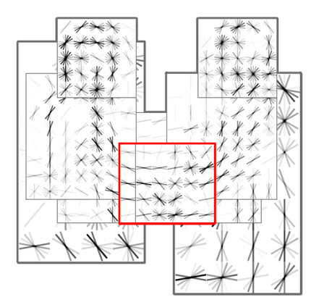
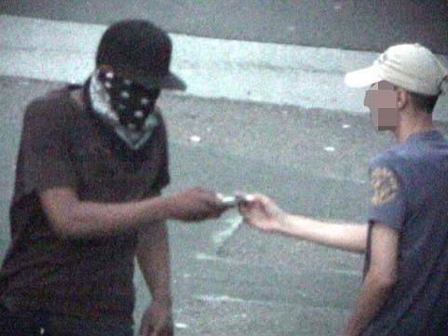
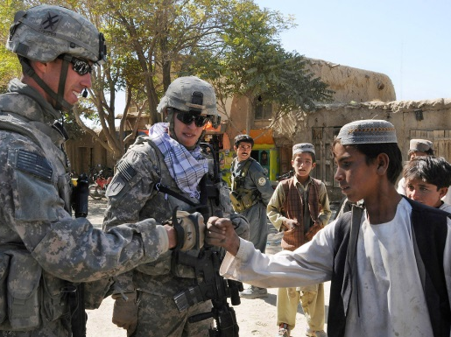
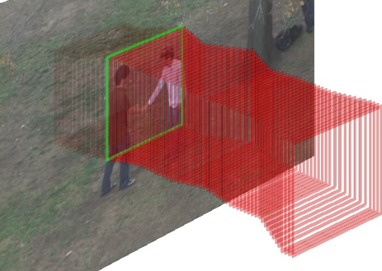
Seeking Interactions Ronald Poppe and Coert van Gemeren
We have developed software to detect interactions in video
Challenges: scaling up, to understand social behavior
Thanks!
Interactions are characterized by the coordination of our bodies
Interactions with others give meaning to our behavior

