Slide 1
IV-e: e-Infrastructure Virtualization for e-Science Applications (P20)
VU University Amsterdam
University of Amsterdam
Delft University of Technology
TNO
Solvinity
LIACS
ONVZ
Henri Bal

Slide 2
P20 in 140 characters

Slide 3
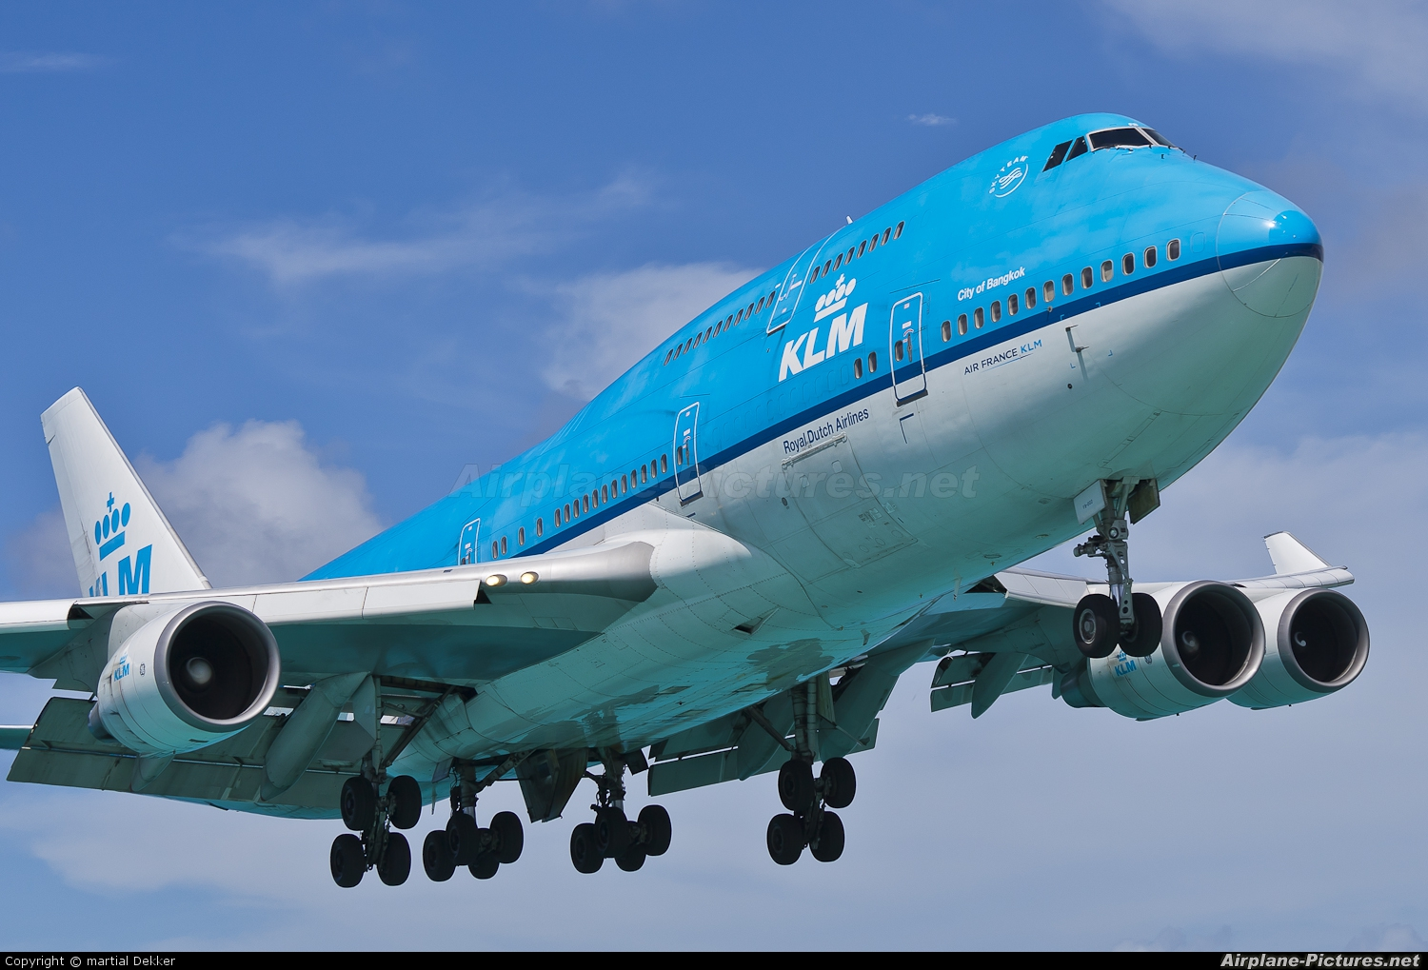
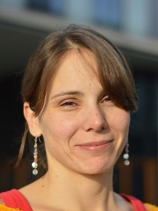
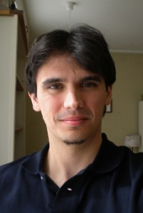
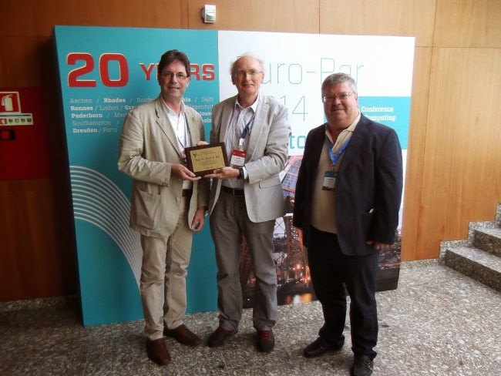
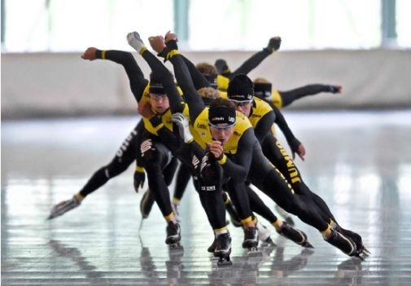
126 left
38 left
65 left
91 left
char P20[140];
Dutch ICT Research
Young KNAW
VIDI
URC
3 VENI
EuroPar
5 Best Paper
ONVZ
Lotto-Jumbo
Bitbrains
KLM

Slide 4
13 left
18 left
0 left
31 left
6 H2020
EPD, Whitebox
DAS-5
11 PhD theses

Slide 5
TOP Publications
IEEE Computer 2016: strategy of and achievements with the DAS systems
IEEE Computer 2015: datacenter management jointly with industry (Bitbrains)
ICDCS 2015: Scalable, Instant VM Startup for IaaS Clouds
HPDC 2014: storing VM images in clouds
SIGMETRICS 2014: big data processing with MapReduce
ICDCS 2014: distributed middleware for MapReduce and stream processing
TPDS 2014: Parallel Workload Modeling with Realistic Characteristics
ISWC 2013: distributed reasoning on dynamic semantic web data
SC 2013: VM deployment
SC 2013: portfolio scheduling
IEEE Big Data 2013: first Dutch article in a top big data conference
IEEE Internet Computing 2013: Distributed Computing on an Ensemble of Browsers
IEEE Internet Computing 2012: Enabling Web Services to Consume and Produce Large Datasets
TPDS 2012: Cost-driven Scheduling of Grid Workflows Using Partial Critical Paths
IEEE Internet Computing 2011: Grid Computing Workloads
ISWC 2011: an OWL reasoner that scales to 1 billion triples
TPDS 2011: performance analysis of cloud services; highest cited in the highest impact journal in the field, for the period 2009-2014
HPDC 2011: Incremental Placement of Interactive Perception Applications

